Slide 1
PYTHON PROGRAMMING SCSA1204
SATHYABAMA
Institute of Science and Technology
Deemed to be University
Chennai.

Slide 2
UNIT 1 INTRODUCTION

Slide 3
SYLLABUS
History of Python
Introduction to the IDLE interpreter (shell)
Expressions
Data Types
Built-in function
Conditional statements
Iterative statements
Input/output
Compound Data Types
Nested compound statements
Introduction to Object Oriented Concepts.

Slide 4
History
Python is a widely used general-purpose, high-level programming language.
Python was conceived in the late 1980s by Guido van Rossum at Centrum Wiskunde & Informatica (CWI) in the Netherlands.
Its implementation began in December 1989.
It was mainly developed for emphasis on code readability, and its syntax allows programmers to express concepts in fewer lines of code.

Slide 5
Cont..
The language was finally released in 1991. When it was released, it used a lot fewer codes to express the concepts, when we compare it with Java, C++ & C.
Its design philosophy was quite good too. Its main objective is to provide code readability and advanced developer productivity.
When it was released it had more than enough capability to provide classes with inheritance, several core data types exception handling and functions.

Slide 6
In 1994, Python 1.0 was released with new features like lambda, map, filter, and reduce.
Python 2.0 added new features such as list comprehensions, garbage collection systems.
On December 3, 2008, Python 3.0 (also called "Py3K") was released. It was designed to rectify the fundamental flaw of the language.

Slide 7
Make it Clear Why We Want to Learn
The goal should be clear before learning the Python. Python is an easy, a vast language as well. It includes numbers of libraries, modules, in-built functions and data structures. If the goal is unclear then it will be a boring and monotonous journey of learning Python. Without any clear goal, you perhaps won't make it done.
So, first figure out the motivation behind learning, which can anything be such as knowing something new, develop projects using Python, switch to Python, etc. Below are the general areas where Python is widely used. Pick any of them.
Data Analysis and Processing
Artificial Intelligence
Games
Hardware/Sensor/Robots
Desktop Applications

Slide 8
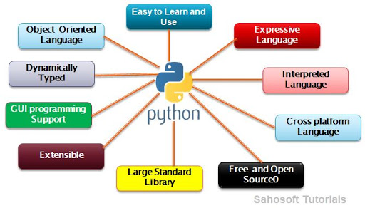
Features of Python

Slide 9
Introduction to the IDLE interpreter
Python is a freeware that can be installed on your workstation or laptop.
The current version of is Python 3.8.2. (Release date: Feb 24, 2020). Python can be downloaded from the https://www.python.org/downloads/ website
IDLE (Integrated Development and Learning Environment) is an IDE for Python
Python programs can also be executed in Python command line.

Slide 10
Example
let's see an example code. Consider a program where you want the user to enter something from the keyboard and you want to save that value in a variable.
For C++, a popular programming language, here is how you will be writing it:

Slide 11
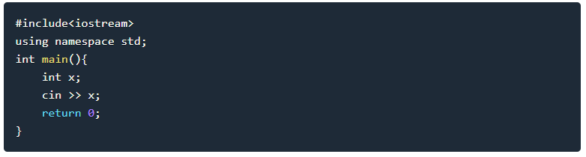
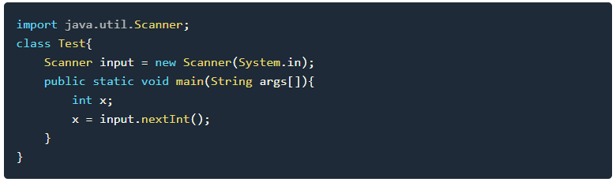
For Core Java, another popular programming language, it will be:

Slide 12
And in Python,
That's all it will take.
No file importing, no curly braces, no semicolons and just one line.
It's really not necessary to understand that code piece right now. It was just meant to demonstrate you that how Python can be a programmer's relief.
Another thing that can be noticed in above code is, in the case of C++ and Java user can only type any integer as the input to variable x,
because we have declared value x as an integer by specifying the code: int x;. In case of Python,
programmers don't have to explicitly specify the data type while declaring a variable, python's compiler will do that itself, based on the type of value assigned to the variable.

Slide 13
Introduction to IDLE - Default Python IDE
You can do it by typing IDLE in Windows/Mac/Linux search bar and it should appear.(After Installation of Python)

Slide 14
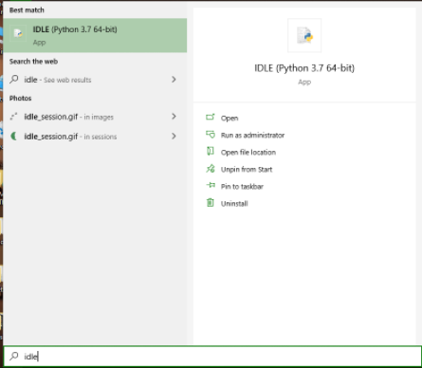

Slide 15
You can see the cursor blinking right after >>>. This is where you will be writing your code. Also, the current running version of Python is also mentioned at the top.
In IDLE we write code line by line. One line will handle one thing. You type whatever you want in that line and press enter to execute it. IDLE works more like a terminal or command prompt - You write one line, press enter, it executes.

Slide 16
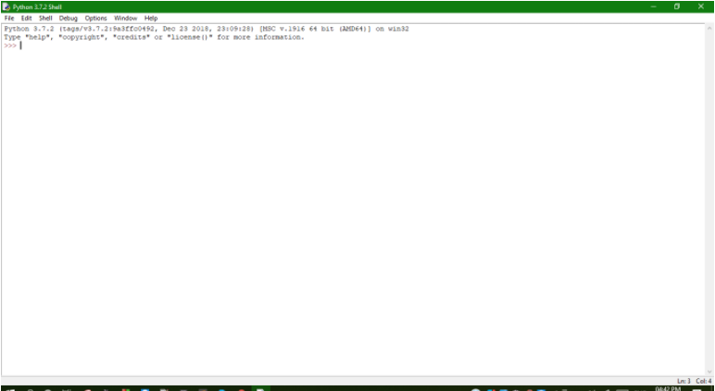

Slide 17
We can also create python file which will contain the complete multiline program and can execute that using IDLE as well. A python script has an extension .py.
Python takes some time to compile, its compilation is not fast, thus writing the example code in a file, then compiling the whole code again and again gets tedious and is not suited for beginners. When we open the IDLE, a session is created, which saves all the lines of code that you write and execute in that one window as a single program.

Slide 18
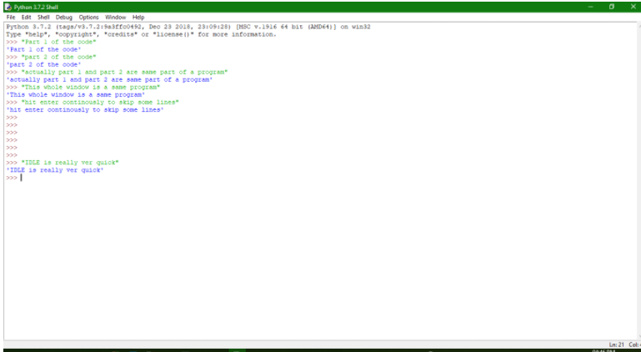

Slide 19
Python Syntax Rules
-Python is case sensitive. Hence a variable with
name “python” is not same as pYThon.
-For path specification, python uses forward slashes. Hence if you are working with a file, the default path for the file in case of Windows OS will have backward slashes, which you will have to convert to forward slashes to make them work in your python script
-Eg: For window's path C:\folderA\folderB relative python program path should be C:/folderA/folderB

Slide 20
In python, there is no command terminator, which means no semicolon ; or anything. So if you want to print something as output, all you have to do is:
In one line only a single executable statement should be written and the line change act as command terminator in python.
To write two separate executable statements in a single line, you should use a semicolon ;
to separate the commands.
For example,

Slide 21
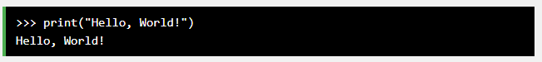
Execute Python Syntax
As we learned in the previous page, Python syntax can be executed by writing directly in the Command Line:
Or by creating a python file on the server, using the .py file extension, and running it in the Command Line:

Slide 22
Python Indentation
Indentation refers to the spaces at the beginning of a code line.
Where in other programming languages the indentation in code is for readability only, the indentation in Python is very important.
Python uses indentation to indicate a block of code.
Example
if 5 > 2: print("Five is greater than two!")

Slide 23
Python will give you an error if you skip the indentation:
Example
Syntax Error:
if 5 > 2: print("Five is greater than two!")

Slide 24
Points to Remember while Writing a Python Program ➢
Case sensitive
Punctuation is not required at end of the statement
In case of string use single or double quotes i.e. ‘ ’ or “ ”
Must use proper indentation
Python Program can be executed in two different modes:
Interactive Mode Programming
Script mode programming

Slide 25
Expressions
In Python, operators are special symbols that designate that some sort of computation should be performed. The values that an operator acts on are called operands.
>>> a = 10
>>> b = 20
>>> a + b
30

Slide 26
In this case, the + operator adds the operands a and b together. An operand can be either a literal value or a variable that references an object:
>>> a = 10
>>> b = 20
>>> a + b - 5
25

Slide 27
Arithmetic Operators
Comparison Operators
Logical Operators
Bitwise Operators
Identity Operators

Slide 28
Expression
An expression is a combination of variables, operators, values and calls to functions.
Expressions need to be evaluated
Example:
z= a+b
p=3.14*r*r
a>b
2=ab - invalid expression

Slide 29
Arithmetic Operators
The following table lists the arithmetic operators supported by Python:
Operator | Example | Meaning | Result
+ (unary) | +a | Unary Positive | a In other words, it doesn’t really do anything. It mostly exists for the sake of completeness, to complement Unary Negation.
+ (binary) | a + b | Addition | Sum of a and b
- (unary) | -a | Unary Negation | Value equal to a but opposite in sign
- (binary) | a - b | Subtraction | b subtracted from a
* | a * b | Multiplication | Product of a and b
/ | a / b | Division | Quotient when a is divided by b. The result always has type float.
% | a % b | Modulo | Remainder when a is divided by b
// | a // b | Floor Division (also called Integer Division) | Quotient when a is divided by b, rounded to the next smallest whole number
** | a ** b | Exponentiation | a raised to the power of b

Slide 30
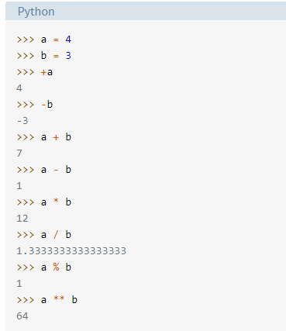

Slide 31
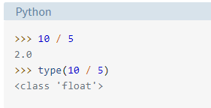
The result of standard division (/) is always a float, even if the dividend is evenly divisible by the divisor:

Slide 32
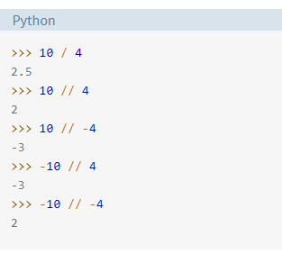
When the result of floor division (//) is positive, it is as though the fractional portion is truncated off, leaving only the integer portion. When the result is negative, the result is rounded down to the next smallest (greater negative) integer:

Slide 33
Comparison Operators
Operator | Example | Meaning | Result
== | a == b | Equal to | True if the value of a is equal to the value of b False otherwise
!= | a != b | Not equal to | True if a is not equal to b False otherwise
< | a < b | Less than | True if a is less than b False otherwise
<= | a <= b | Less than or equal to | True if a is less than or equal to b False otherwise
> | a > b | Greater than | True if a is greater than b False otherwise
>= | a >= b | Greater than or equal to | True if a is greater than or equal to b False otherwise

Slide 34
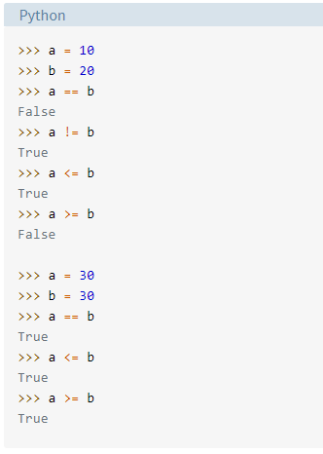
Comparison operator example

Slide 35
Python Data Types
Variables can hold values, and every value has a data-type. Python is a dynamically typed language; hence we do not need to define the type of the variable while declaring it. The interpreter implicitly binds the value with its type.
a = 5
The variable a holds integer value five and we did not define its type. Python interpreter will automatically interpret variables a as an integer type.
Python enables us to check the type of the variable used in the program. Python provides us the type() function, which returns the type of the variable passed.

Slide 36
Data Types
A Data type indicates which type of value a variable has in a program.
The most common data types used in python are
str (string)
int(integer)
float (floating-point).

Slide 37
VARIABLES
Variable is the name given to a reserved memory locations to store values.
It is also known as Identifier in python.
Naming and Initialization of a variable
1. A variable name is made up of alphabets (Both upper and lower cases) and digits and is case sensitive
2. No reserved words
3. Initialize before calling
4. Multiple variables initialized
5. Dynamic variable initialization

Slide 38
Example
X2=25
if=30
a=45
print(A)
x=y=z=50
a,b,c=1,2,3
print(a)
print(b)
print(c)

Slide 39
Numeric
Integers –
int – both +ve and –ve values can be represented
Float – float class is used to represent floating point number which is a real number with floating point representation.
float
fractional point E.g.: 3.415, 5.15
Complex Numbers
complex
For example: 5 + 7j
where 5 is the real part and 7 is the imaginary part

Slide 40
Number Type Conversion
int(x) - to convert x to a plain integer.
long(x) -to convert x to a long integer.
float(x) -to convert x to a floating-point number.
complex(x) -to convert x to a complex number with real part x and imaginary part zero.
complex(x, y) - to convert x and y to a complex number with real part x and imaginary part y. x and y are numeric expressions

Slide 41
Example
Program:
a = 10
print("Type of a: ", type(a))
b = 20.0
print("\nType of b: ", type(b))
c = 5 + 7j
print("\nType of c: ", type(c))
Output:
Type of a: <class 'int'>
Type of b: <class 'float'>
Type of c: <class 'complex'>

Slide 42
Standard data types
A variable can hold different types of values. For example, a person's name must be stored as a string whereas its id must be stored as an integer.
Python provides various standard data types that define the storage method on each of them. The data types defined in Python are given below.
Numbers
Sequence Type
Boolean
Set
Dictionary

Slide 43
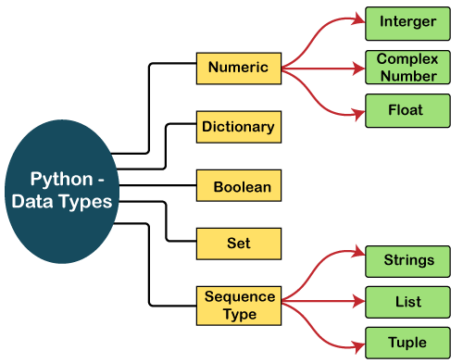

Slide 44
Numbers
Number stores numeric values. The integer, float, and complex values belong to a Python Numbers data-type. Python provides the type() function to know the data-type of the variable. Similarly, the isinstance() function is used to check an object belongs to a particular class.
Python creates Number objects when a number is assigned to a variable. For example;

Slide 45
Example
Consider the following example to define the values of different data types and checking its type.
a=10
b="Hi Python"
c = 10.5
print(type(a))
print(type(b))
print(type(c))
Output:
<class 'int’> <class 'str’> <class 'float'>

Slide 46
Eg:
x=isinstance(5,int)
print(x)
Output:
True

Slide 47
a = 5
print("The type of a", type(a))
b = 40.5
print("The type of b", type(b))
c = 1+3j
print("The type of c", type(c))
print(" c is a complex number", isinstance(1+3j,complex))

Slide 48
Output:
The type of a <class 'int'>
The type of b <class 'float'>
The type of c <class 'complex'>
c is complex number: True

Slide 49
Python supports three types of numeric data.
Int - Integer value can be any length such as integers 10, 2, 29, -20, -150 etc. Python has no restriction on the length of an integer. Its value belongs to int
Float - Float is used to store floating-point numbers like 1.9, 9.902, 15.2, etc. It is accurate upto 15 decimal points.
complex - A complex number contains an ordered pair, i.e., x + iy where x and y denote the real and imaginary parts, respectively. The complex numbers like 2.14j, 2.0 + 2.3j, etc.

Slide 50
Type Conversion Convert from one type to another:
x = 1 # int y = 2.8 # float z = 1j # complex #convert from int to float: a = float(x) #convert from float to int: b = int(y) #convert from int to complex: c = complex(x) print(a) print(b) print(c) print(type(a)) print(type(b)) print(type(c))

Slide 51
Random Number
Python does not have a random() function to make a random number,
but Python has a built-in module called random that can be used to make random numbers:
import random print(random.randrange(1, 10))

Slide 52
Sequence Type
A sequence is an ordered collection of similar or different data.
Using sequence, Multiple values can be stored in the data type in an efficient manner.
There are different types of sequence data type such as
i) Strings ii) List iii) Tuple

Slide 53
Sequence Type
String
The string can be defined as the sequence of characters represented in the quotation marks. In Python, we can use single, double, or triple quotes to define a string.
String handling in Python is a straightforward task since Python provides built-in functions and operators to perform operations in the string.
In the case of string handling, the operator + is used to concatenate two strings as the operation "hello"+" python" returns "hello python".
The operator * is known as a repetition operator as the operation "Python" *2 returns 'Python Python'

Slide 54
Strings
String is an array of bytes.
Each byte represents a Unicode character.
A string is a collection of one or more characters put in a single quote, double-quote or triple quote.
In python there is no character data type, a character is a string of length one.
It is represented by str class.
Individual characters of a string can be accessed by using the method of Indexing

Slide 55
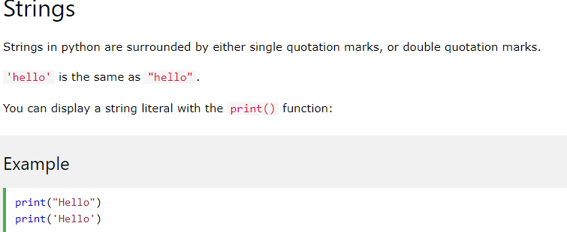
Examples

Slide 56
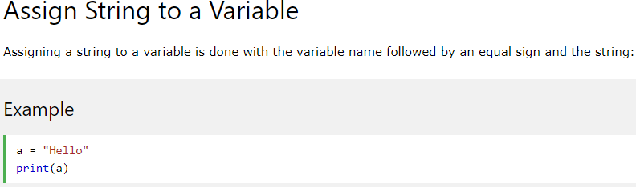
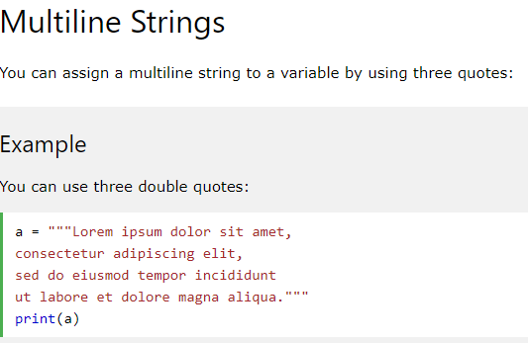

Slide 57
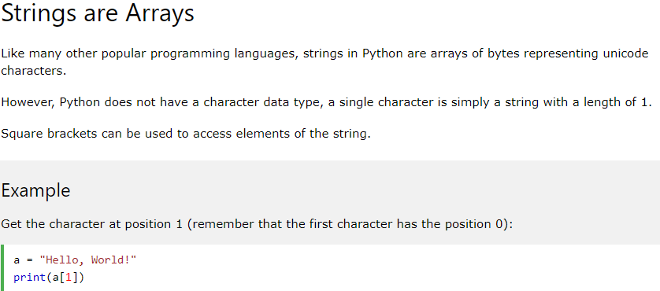

Slide 58
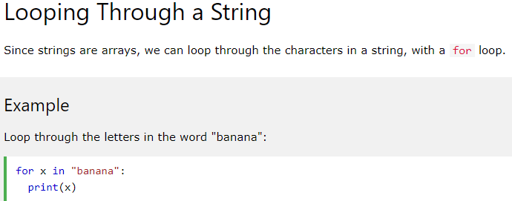
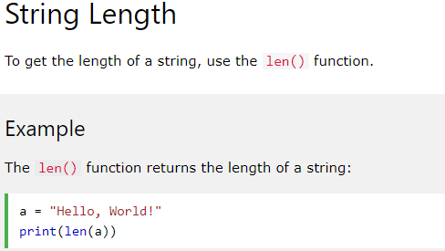

Slide 59
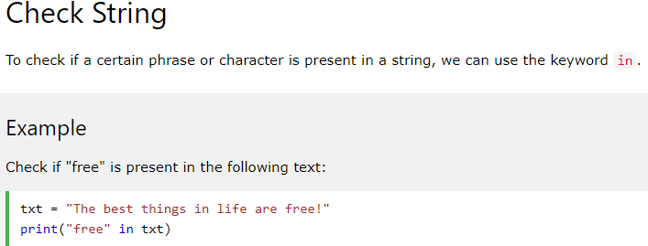
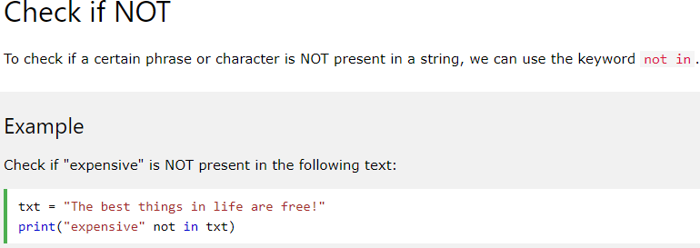

Slide 60
The following example illustrates the string in Python.
Example - 1
str = "string using double quotes"
print(str)
s = '''''A multiline
string'''
print(s)
Output:
string using double quotes A multiline string

Slide 61
Consider the following example of string handling.
Example - 2
str1 = 'hello javatpoint' #string str1
str2 = ' how are you' #string str2
print (str1[0:2]) #printing first two character using slice operator
print (str1[4]) #printing 4th character of the string
print (str1*2) #printing the string twice
print (str1 + str2) #printing the concatenation of str1 and str2
Output:
he
o
hello stringhello string
hello string how are you

Slide 62
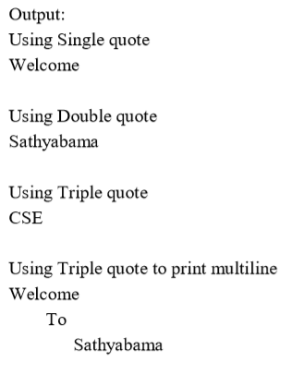
Example
Strings: Sequence of characters inside single quotes or double quotes.
E.g. myuniv = “Sathyabama !..”
PROGRAM:
# Python Program for String Manipulation
# Creating a String with single quotes, double quotes, tripple quotes
String1 = 'Welcome’
String2 = "Sathyabama"
String3 = '''CSE’‘’ # Triple Quotes allows multiple lines
String4 = '''Welcome
To
Sathyabama‘’’
print("\nUsing Single quote")
print(String1)
print("\nUsing Double quote")
print(String2)
print("\nUsing Triple quote")
print(String3)
print("\nUsing Triple quote to print multiline")
print(String4)

Slide 63
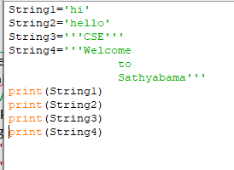

Slide 64
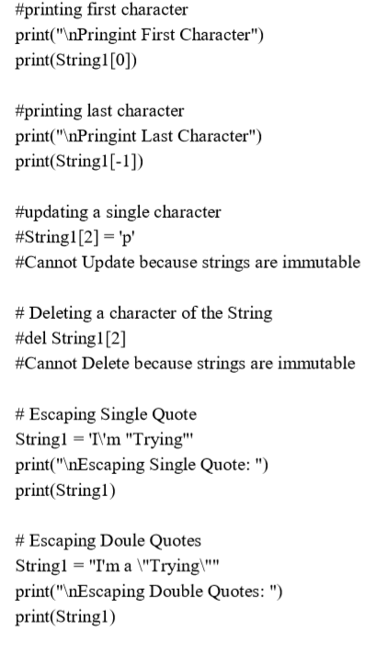
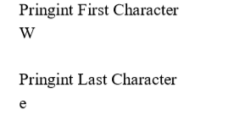
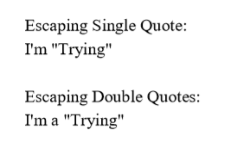

Slide 65
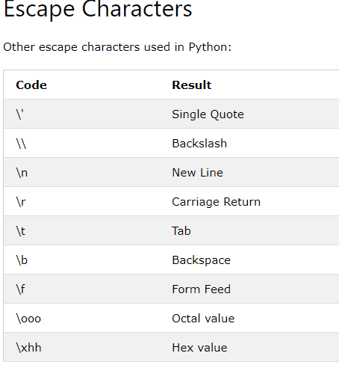
Escape Characters

Slide 66
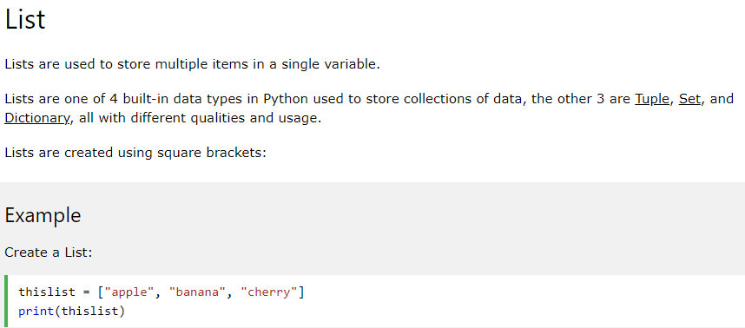
List

Slide 67
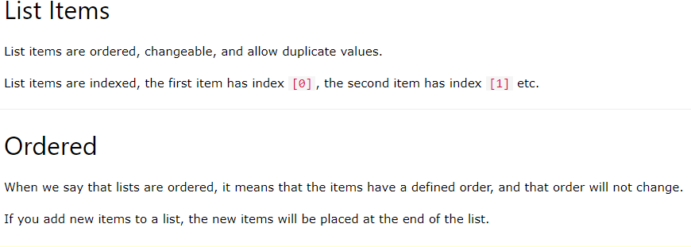

Slide 68
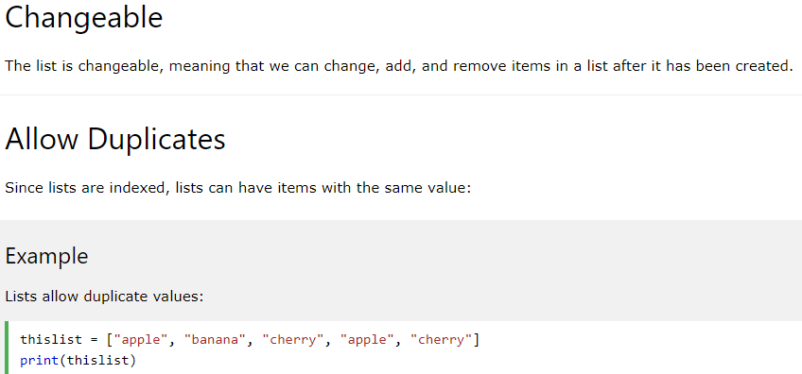

Slide 69
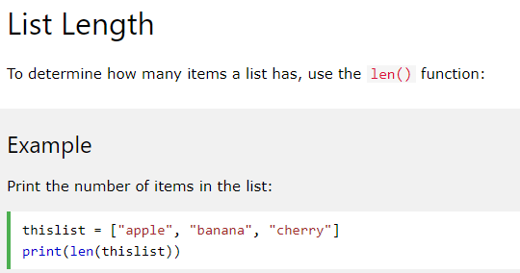
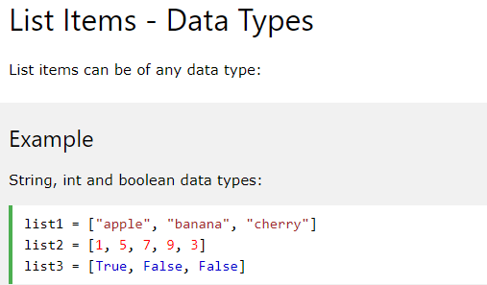

Slide 70
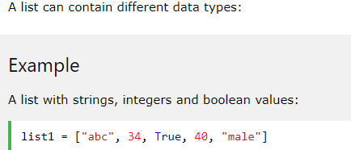
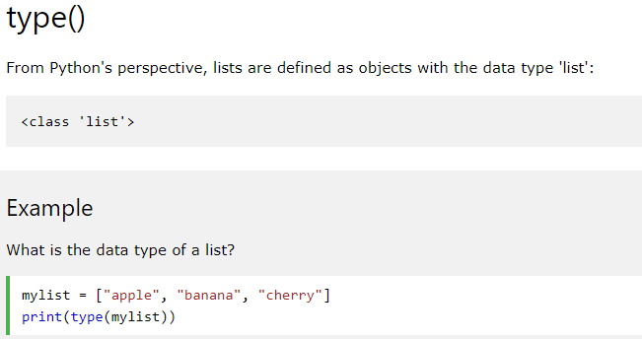

Slide 71
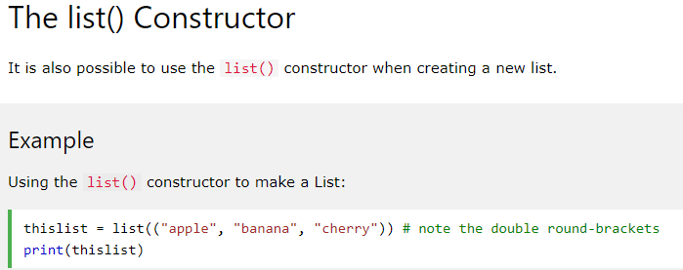
The list() constructor returns a list. If no parameters are passed, it returns an empty list. If iterable is passed as a parameter, it creates a list consisting of iterable's items.

Slide 72
List
Python Lists are similar to arrays in C. However, the list can contain data of different types. The items stored in the list are separated with a comma (,) and enclosed within square brackets [].
We can use slice [:] operators to access the data of the list. The concatenation operator (+) and repetition operator (*) works with the list in the same way as they were working with the strings.

Slide 73
List Example
list1 = [1, "hi", "Python", 2]
#Checking type of given list
print(type(list1))
#Printing the list1
print (list1)
# List slicing
print (list1[3:])
# List slicing
print (list1[0:2])
# List Concatenation using + operator
print (list1 + list1)
# List repetation using * operator
print (list1 * 3)

Slide 74
Output:
[1, 'hi', 'Python', 2]
[2]
[1, 'hi']
[1, 'hi', 'Python', 2, 1, 'hi', 'Python', 2]
[1, 'hi', 'Python', 2, 1, 'hi', 'Python', 2, 1, 'hi', 'Python', 2]

Slide 75
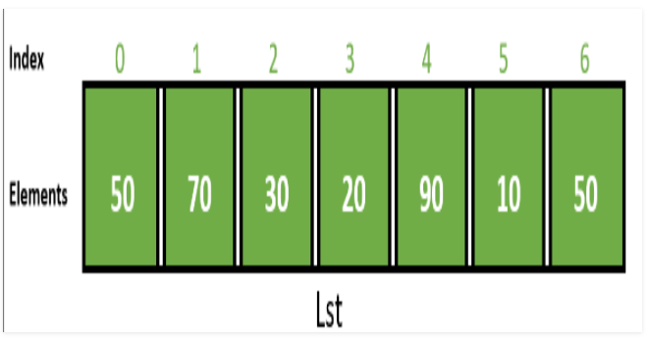
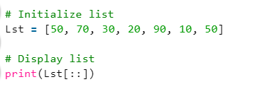
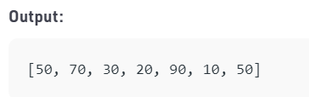

Slide 76
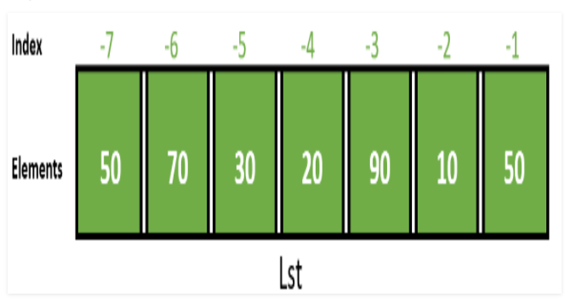
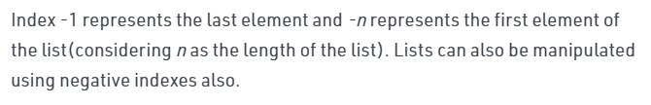

Slide 77
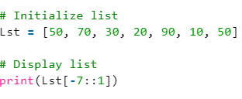
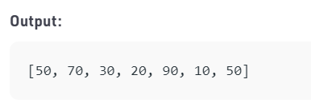

Slide 78
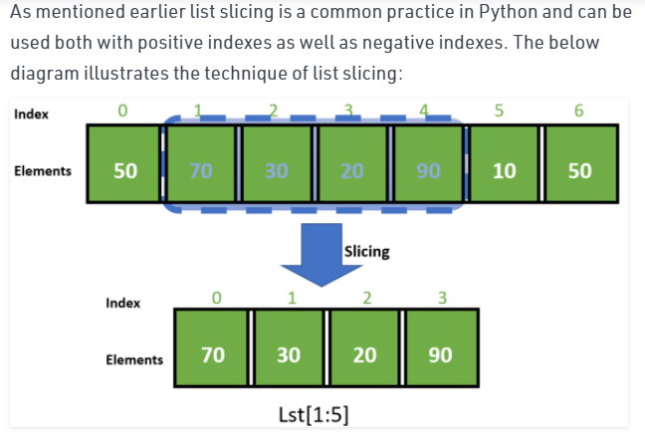
Slicing

Slide 79
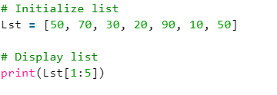
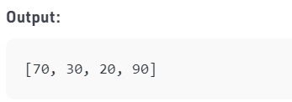

Slide 80
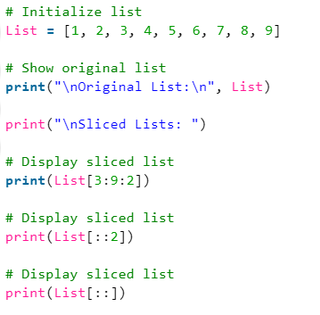
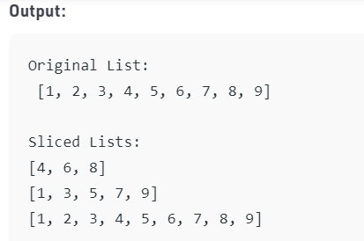
Example1

Slide 81
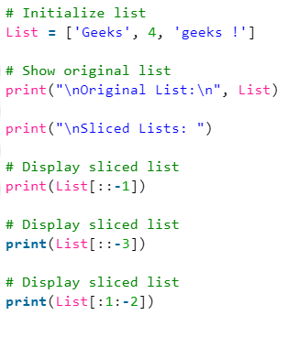
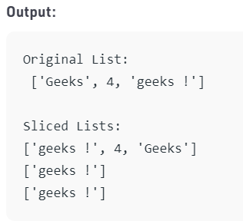
Example 2

Slide 82
List
The List is an ordered sequence of data items.
It is one of the flexible and very frequently used data type in Python.
All the items in a list are not necessary to be of the same data type.
Declaring a list is straight forward methods.
Items in the list are just separated by commas and enclosed within brackets [ ]
Example: li=[10,2,3,45]
list1 =[3.141, 100, ‘CSE’, ‘ECE’, ‘IT’, ‘EEE’]

Slide 83
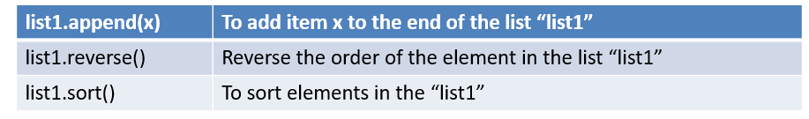
List Methods
A single list may contain Data Types like Integers, Strings, as well as Objects.
Lists are mutable.
Lists are ordered and have definite count.
The list index starts with 0.
Duplication of elements is possible in list. The lists are implemented by list class.

Slide 84
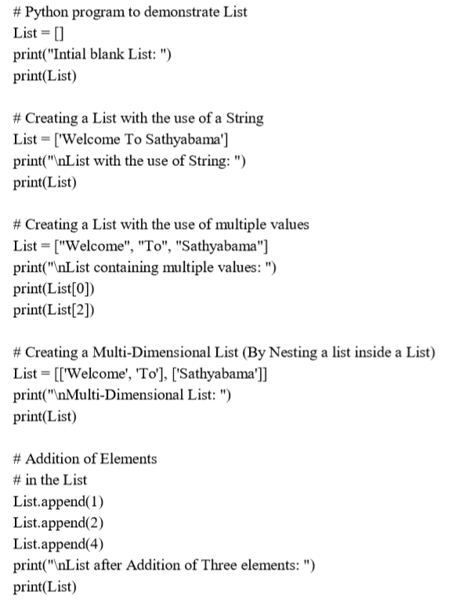


Slide 85



Slide 86





Slide 87




Slide 88
Tuple
A tuple is similar to the list in many ways. Like lists, tuples also contain the collection of the items of different data types. The items of the tuple are separated with a comma (,) and enclosed in parentheses ().
A tuple is a read-only data structure as we can't modify the size and value of the items of a tuple.
Let's see a simple example of the tuple.

Slide 89



Slide 90



Slide 91


Slide 92



Slide 93


Slide 94
Tuple Example
tup = ("hi", "Python", 2)
# Checking type of tup
print (type(tup))
#Printing the tuple
print (tup)
# Tuple slicing
print (tup[1:])
print (tup[0:1])
# Tuple concatenation using + operator
print (tup + tup)
# Tuple repatation using * operator
print (tup * 3)
# Adding value to tup. It will throw an error.
t[2] = "hi"

Slide 95
Output:
<class 'tuple'>
('hi', 'Python', 2)
('Python', 2)
('hi',)
('hi', 'Python', 2, 'hi', 'Python', 2)
('hi', 'Python', 2, 'hi', 'Python', 2, 'hi', 'Python', 2)
Traceback (most recent call last):
File "main.py", line 14, in <module>
t[2] = "hi";
TypeError: 'tuple' object does not support item assignment

Slide 96

Tuple
Tuple is also an ordered sequence of items of different data types like list.
But, in a list data can be modified even after creation of the list whereas Tuples are immutable and cannot be modified after creation.
Example: t = (50,'python', 2+3j)

Slide 97




Slide 98



Slide 99
Dictionary
Dictionary is an unordered set of a key-value pair of items. It is like an associative array or a hash table where each key stores a specific value. Key can hold any primitive data type, whereas value is an arbitrary Python object.
The items in the dictionary are separated with the comma (,) and enclosed in the curly braces {}.

Slide 100
Dictionary
Dictionary is an unordered collection of data values.
It is used to store data values like a map.
Dictionary holds key:value pair.
Key-value is provided in the dictionary to make it more optimized.
Each key-value pair is separated by a colon :, whereas each key is separated by a ‘comma’.
Example: dict={1:”Jan”, 2:”Feb”, 3:”March”}

Slide 101
Example
d = {1:'Jimmy', 2:'Alex', 3:'john', 4:'mike'}
# Printing dictionary
print (d)
# Accesing value using keys
print("1st name is "+d[1])
print("2nd name is "+ d[4])
print (d.keys())
print (d.values())

Slide 102
Output:
1st name is Jimmy
2nd name is mike
{1: 'Jimmy', 2: 'Alex', 3: 'john', 4: 'mike'} dict_keys([1, 2, 3, 4])
dict_values(['Jimmy', 'Alex', 'john', 'mike'])

Slide 103


Slide 104


Slide 105


Slide 106


Slide 107



Slide 108



Slide 109



Slide 110




Slide 111



Slide 112
Boolean
Boolean type provides two built-in values, True and False. These values are used to determine the given statement true or false. It denotes by the class bool.
True can be represented by any non-zero value or 'T' whereas false can be represented by the 0 or 'F'. Consider the following example.

Slide 113
# Python program to check the boolean type
print(type(True))
print(type(False))
print(false)
Output:
<class 'bool'>
<class 'bool'>
NameError: name 'false' is not defined

Slide 114
Boolean
The Boolean data type has two built-in values True or False.
It is denoted by the class bool.
Note – True and False with capital ‘T’ and ‘F’ are valid boolean values.
# Python program to demonstrate Boolean type print(type(True))
print(type(False))
print(type(true))
Output:
<class 'bool’>
<class 'bool’>
NameError: name 'false' is not defined

Slide 115
Python Set
Python Set is the unordered collection of the data type. It is iterable, mutable(can modify after creation), and has unique elements. In set, the order of the elements is undefined; it may return the changed sequence of the element.
The set is created by using a built-in function set(), or a sequence of elements is passed in the curly braces and separated by the comma. It can contain various types of values. Consider the following example.

Slide 116
# Creating Empty set
set1 = set()
set2 = {'James', 2, 3,'Python'}
#Printing Set value
print(set2)
# Adding element to the set
set2.add(10)
print(set2)
#Removing element from the set
set2.remove(2)
print(set2)

Slide 117
Output:
{3, 'Python', 'James', 2}
{'Python', 'James', 3, 2, 10}
{'Python', 'James', 3, 10}

Slide 118

Set
The Set is an unordered collection of unique data items.
Items in a set are not ordered, separated by comma and enclosed inside { } braces.
Sets are helpful in performing operations like union and intersection.
The major advantage of using a set, as opposed to a list, is that it has a highly optimized method for checking whether a specific element is contained in the set.

Slide 119






Slide 120



Slide 121





Slide 122

Difference Between List Tuple Set And Dictionary

Slide 123

Python Built-in Functions
A function is a group of statements that performs a specific task. Python provides a library of functions like any other programming language.
Mathematical Functions, String Functions

Slide 124
Mathematical Functions
Sr.No. | Function & Returns ( Description )
1 | abs(x) -The absolute value of x: the (positive) distance between x and zero.
2 | fabs(x) -The absolute value of x.
3 | ceil(x)-The ceiling of x: the smallest integer not less than x.
4 | floor(x) -The floor of x: the largest integer not greater than x.
5 | log(x) -The natural logarithm of x, for x > 0.
6 | min(x1, x2,...)-The smallest of its arguments: the value closest to negative infinity.
7 | modf(x) -The fractional and integer parts of x in a two-item tuple. Both parts have the same sign as x. The integer part is returned as a float.
8 | pow(x, y) -The value of x**y.
9 | round(x [,n]) -x rounded to n digits from the decimal point. Python rounds away from zero as a tie-breaker: round(0.5) is 1.0 and round(-0.5) is -1.0.

Slide 125


Mathematical Functions

Slide 126

Conditional Statements
Logical Conditions Supported by Python
Equal to (==) Eg: a == b
Not Equal (!=) Eg : a != b
Greater than (>) Eg: a > b
Greater than or equal to (>=) Eg: a >= b
Less than (<) Eg: a < b
Less than or equal to (<=) Eg: a <= b

Slide 127



Types of Conditional Statements
Simple if statement
if – else statement
elif- statement
Nested if else statement

Slide 128






Slide 129
Python supports the usual logical conditions from mathematics:
Equals: a == b
Not Equals: a != b
Less than: a < b
Less than or equal to: a <= b
Greater than: a > b
Greater than or equal to: a >= b
These conditions can be used in several ways, most commonly in "if statements" and loops.
An "if statement" is written by using the if keyword.

Slide 130
Example
If statement:
a = 33 b = 200 if b > a: print("b is greater than a")

Slide 131
In this example we use two variables, a and b, which are used as part of the if statement to test whether b is greater than a.
As a is 33, and b is 200, we know that 200 is greater than 33, and so we print to screen that "b is greater than a".

Slide 132
Indentation
Python relies on indentation (whitespace at the beginning of a line) to define scope in the code. Other programming languages often use curly-brackets for this purpose.
Example
If statement, without indentation (will raise an error):
a = 33 b = 200 if b > a: print("b is greater than a") # you will get an error

Slide 133
Elif
The elif keyword is pythons way of saying "if the previous conditions were not true, then try this condition".
Example
a = 33 b = 33 if b > a: print("b is greater than a") elif a == b: print("a and b are equal")
In this example a is equal to b, so the first condition is not true, but the elif condition is true, so we print to screen that "a and b are equal".

Slide 134
Else
The else keyword catches anything which isn't caught by the preceding conditions.
Example
a = 200 b = 33 if b > a: print("b is greater than a") elif a == b: print("a and b are equal") else: print("a is greater than b")
In this example a is greater than b, so the first condition is not true, also the elif condition is not true,
so we go to the else condition and print to screen that "a is greater than b".
You can also have an else without the elif:

Slide 135
Example
a = 200 b = 33 if b > a: print("b is greater than a") else: print("b is not greater than a")

Slide 136
Short Hand If
If you have only one statement to execute, you can put it on the same line as the if statement.
Example
One line if statement:
if a > b: print("a is greater than b")

Slide 137
Short Hand If ... Else
If you have only one statement to execute, one for if, and one for else, you can put it all on the same line:
Example
One line if else statement:
a = 2 b = 330 print("A") if a > b else print("B")

Slide 138
You can also have multiple else statements on the same line:
Example
One line if else statement, with 3 conditions:
a = 330 b = 330 print("A") if a > b else print("=") if a == b else print("B")

Slide 139
And
The and keyword is a logical operator, and is used to combine conditional statements:
Example
Test if a is greater than b, AND if c is greater than a:
a = 200 b = 33 c = 500 if a > b and c > a: print("Both conditions are True")

Slide 140
Nested If
You can have if statements inside if statements, this is called nested if statements.
Example
x = 41 if x > 10: print("Above ten,") if x > 20: print("and also above 20!") else: print("but not above 20.")

Slide 141
The pass Statement
-The pass statement is used as a placeholder for future code. When the pass statement is executed, nothing happens, but you avoid getting an error when empty code is not allowed. Empty code is not allowed in loops, function definitions, class definitions, or in if statements
-if statements cannot be empty, but if you for some reason have an if statement with no content, put in the pass statement to avoid getting an error.
Example
a = 33 b = 200 if b > a: pass

Slide 142
Iterative Statements
Sometimes certain section of the code (block) may need to be repeated again and again as long as certain condition remains true.
while loop statement
For loop statement

Slide 143


While Loop
A while loop statement in Python programming language repeatedly executes a target statement as long as a given condition is true.

Slide 144






Using break, continue, else Statements

Slide 145




For loop
With the for loop we can execute a set of statements, once for each item in a list, tuple, set etc.

Slide 146







Slide 147






The range() Function
range() only works with the integers.
All arguments must be integers.
You can not use float number or any other type in a start, stop and step argument of a range()

Slide 148






_ -ve range()
-ve to +ve range
+ ve to –ve range

Slide 149


Example

Slide 150
Input & Output Statements
Input – to read values from the user
Syntax:
Variable=input()
Input() – function used to read values
Output- to display the result
Syntax:
print(“hello students”)
print(“welcome”)
Print(“value is”,x)

Slide 151
Input and Output in Python
Taking Input from the user
Sometimes a developer might want to take input from the user at some point in the program. To do this Python provides an input() function.
Syntax:
input('prompt')
where, prompt is a string that is displayed on the string at the time of taking input.

Slide 152
Example 1: Taking input from the user with a message.
# Taking input from the user
name = input("Enter your name: ")
# Output
print("Hello, " + name)
Output:
Enter your name: Gfg Hello, Gfg

Slide 153
Example 2: By default input() function takes the user’s input in a string. So, to take the input in the form of int, you need to use int() along with input function.
# Taking input from the user as integer
num = int(input("Enter a number: "))
add = num + 1
# Output
print(add)
Output:
Enter a number: 25 26

Slide 154
Displaying Output
Python provides the print() function to display output to the cosole.
Syntax: print(value(s), sep= ‘ ‘, end = ‘\n’, file=file, flush=flush)
Parameters: value(s) : Any value, and as many as you like. Will be converted to string before printed sep=’separator’ : (Optional) Specify how to separate the objects, if there is more than one.Default :’ ‘ end=’end’: (Optional) Specify what to print at the end.Default : ‘\n’ file : (Optional) An object with a write method. Default :sys.stdout flush : (Optional) A Boolean, specifying if the output is flushed (True) or buffered (False). Default: False
Returns: It returns output to the screen.

Slide 155
Example 1
# Python program to demonstrate # print() method print("GFG") # code for disabling the softspace feature print('G', 'F', 'G', sep ='') # using end argument print("Python", end = '@') print("GeeksforGeeks")
Output:
GFG
GFG Python@GeeksforGeeks

Slide 156
Formatting Output
Formatting output in Python can be done in many ways. Let’s discuss them below
We can use formatted string literals, by starting a string with f or F before opening quotation marks or triple quotation marks. In this string, we can write Python expressions between { and } that can refer to a variable or any literal value.

Slide 157
# Declaring a variable
name = "Gfg"
# Output
print(f'Hello {name}! How are you?')
Output:
Hello Gfg! How are you?

Slide 158
We can also use format() function to format our output to make it look presentable. The curly braces { } work as placeholders. We can specify the order in which variables occur in the output.

Slide 159
# Intializing variables
a = 20
b = 10
# addition
sum = a + b
# subtraction
sub = a- b
# Output
print('The value of a is {} and b is {}'.format(a,b))
print('{2} is the sum of {0} and {1}'.format(a,b,sum))
print('{sub_value} is the subtraction of {value_a} and {value_b}'.format(value_a = a ,
value_b = b,
sub_value = sub))

Slide 160
Output:
The value of a is 20 and b is 10 30 is the sum of 20 and 10 10 is the subtraction of 20 and 10

Slide 161
We can use ‘%’ operator. % values are replaced with zero or more value of elements.
# Taking input from the user num = int(input("Enter a value: ")) add = num + 5 # Output print("The sum is %d" %add)
Output:
Enter a value: 50 The sum is 55

Slide 163
Compound Data Type
List
Tuple
Set
Dictionary

Slide 164
Compound Statements
It is a statement comprise of group of statements
The compound statements are usually executes, when a condition satisfies or a code block is called directly or through a function call.
Example:
If statement
While Statement
For Statement
Try-Catch in Exception Handling
Class Definition
Function Definition

Slide 165

Nested Compound Statement
Program to find the shipping cost of in Australia, if the total cost is 25$.

Slide 166





Slide 167


Display Floyd’s triangle using Python nested for loop

Slide 168

Functions
A function is a block of organized, reusable code that is used to perform a single, related action.
Functions provide better modularity for your application and a high degree of code reusing.

Slide 169


Example

Slide 170


Pass by Value

Slide 171
Python Functions
A function is a block of code which only runs when it is called.
You can pass data, known as parameters, into a function.
A function can return data as a result.

Slide 172


Creating and calling a function

Slide 173

Arguments

Slide 174


Slide 175


Slide 176


Slide 177


Slide 178

The phrase Keyword Arguments are often shortened to kwargs in Python documentations.

Slide 179

Arbitrary Kword Arguments are often shortened to **kwargs in Python documentations.

Slide 180


Slide 181


Slide 182


Slide 183


Slide 184
Object Oriented Programming
Python is a multi-paradigm programming language. It supports different programming approaches.
One of the popular approaches to solve a programming problem is by creating objects. This is known as Object-Oriented Programming (OOP).
An object has two characteristics:
attributes
behavior
Let's take an example:
A parrot is can be an object, as it has the following properties:
name, age, color as attributes
singing, dancing as behavior

Slide 185
OOPS Concepts
Class and Object
Encapsulation
Abstraction
Inheritance
Polymorphism

Slide 186
Python Classes and Objects
Python Classes/Objects
Python is an object oriented programming language.
Almost everything in Python is an object, with its properties and methods.
A Class is like an object constructor, or a "blueprint" for creating objects.

Slide 187



Slide 188

Note: The __init__() function is called automatically every time the class is being used to create a new object.

Slide 189


Slide 190


Slide 191



Slide 192



Slide 193
Class
A class is a blueprint for the object.
We can think of class as a sketch of a parrot with labels.
It contains all the details about the name, colors, size etc. Based on these descriptions, we can study about the parrot.
Here, a parrot is an object.
The example for class of parrot can be :
Class Parrot:
Data member
Method

Slide 194
Object
An object (instance) is an instantiation of a class. When class is defined, only the description for the object is defined.
Therefore, no memory or storage is allocated.
The example for object of parrot class can be:
Obj=Parrot()
Here: obj-> object
Parrot()-> class

Slide 195


Creating Class and Object in Python

Slide 196


A program to understand class variables s

Slide 197

Constructors
Constructors are generally used for instantiating an object.
The task of constructors is to initialize(assign values) to the data members of the class when an object of class is created.
In Python the __init__() method is called the constructor and is always called when an object is created.

Slide 198
Types of constructors
Default constructor :
The default constructor is simple constructor which doesn’t accept any arguments.
It’s definition has only one argument which is a reference to the instance being constructed.
parameterized constructor :
constructor with parameters is known as parameterized constructor.
The parameterized constructor take its first argument as a reference to the instance being constructed known as self and the rest of the arguments are provided by the programmer.

Slide 199

Default Constructor

Slide 200


Parameterized Constructor

Slide 201
Encapsulation & Abstraction
Encapsulation:
It is a mechanism where the data and the code that act on the data will be bind together.
Example:
Class
Visibility Mode: By default Public
Abstraction:
Explore only the data that is of interest to the user.
Example: Car
Adv: Every user will get his own view of the data according to his requirements and will not confused with unnecessary data.
Keywords: public, private, protected

Slide 202






Access Modifiers in Python

Slide 203
Inheritance
Inheritance allows us to define a class that inherits all the methods and properties from another class.
Parent class is the class being inherited from, also called base class.
Child class is the class that inherits from another class, also called derived class.
Syntax for derived class:
Class A:
Base Class definition
Class B(A):
Derived Definition

Slide 204

Types of Inheritance

Slide 205

Single Inheritance

Slide 206


Multiple Inheritance

Slide 207


Multilevel Inheritance

Slide 208


Hierarchical Inheritance

Slide 209


Examples Below is a simple Python program that creates a class with a single method.

Slide 210
Class:
A class is a blueprint that defines the variables and the methods (Characteristics) common to all objects of a certain kind.
Example: If Car is a class, then Audi A6 is an object of the Car class. All cars share similar features like 4 wheels, 1 steering wheel, windows, breaks etc. Audi A6 (The Car object) has all these features.

Slide 211
The self Class methods must have an extra first parameter in the method definition. We do not give a value for this parameter when we call the method, Python provides it
If we have a method that takes no arguments, then we still have to have one argument – the self. See fun() in the above simple example.
This is similar to this pointer in C++ and this reference in Java.
When we call a method of this object as myobject.method(arg1, arg2), this is automatically converted by Python into MyClass.method(myobject, arg1, arg2) – this is all the special self is about.

Slide 212
The __init__ method The __init__ method is similar to constructors in C++ and Java. It is run as soon as an object of a class is instantiated. The method is useful to do any initialization you want to do with your object.

Slide 213



Slide 214
Class and Instance Variables (Or attributes) In Python, instance variables are variables whose value is assigned inside a constructor or method with self. Class variables are variables whose value is assigned in class.

Slide 215
# Python program to show that the variables with a value
# assigned in class declaration, are class variables and
# variables inside methods and constructors are instance
# variables.
# Class for Computer Science Student
class CSStudent:
# Class Variable
stream = 'cse'
# The init method or constructor
def __init__(self, roll):
# Instance Variable
self.roll = roll
# Objects of CSStudent class
a = CSStudent(101)
b = CSStudent(102)
print(a.stream) # prints "cse"
print(b.stream) # prints "cse"
print(a.roll) # prints 101
# Class variables can be accessed using class
# name also
print(CSStudent.stream) # prints "cse"

Slide 216
Polymorphism
Polymorphism is a very important concept in programming.
It refers to the use of a single type entity (method, operator or object) to represent different types in different scenarios.
Types:
Function Overloading
Operator Overloading

Slide 217

Function Overloading
Process of using same function name to perform multiple operation
Example:

Slide 218

Operator Overloading
Defining methods for operator is known as operator overloading.

Slide 219

Operator Overloading

